Slide 1
Sweet Nothings and the Sweet Truth: The no-calorie, chemically engineered sweetener Splenda is unfit for public distribution and consumption
By Kate Wing

Slide 2
7,000 BC
1879
Beekeeping in practice
Remsen and Fahlburg accidentally discover saccharine
6,000 – 1,000 BC
Sugarcane originated in Papua New Guinea
1937
Michael Sveda (U. Illinois Grad Student) accidentally discovers cyclamate
500 – 250 BC
Sugarcane spreads to India and China
1965
Aspartame is discovered
500 – 600 AD
The Indians boiled sugar cane juice to make crystalline sugar
1975
Sucralose is discovered by Sashikant Phadis at Queen’s Collage in London while developing pesticides
1000 AD
Sugar was taken to Europe by crusaders
1492
1998
Columbus brought sugar cane to the Caribbean
Sucralose is approved for use

Slide 3
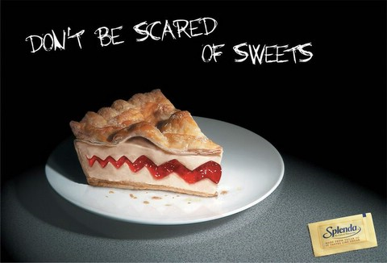
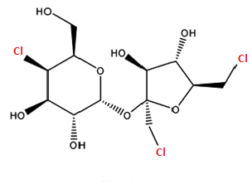
What is Splenda?
Splenda is manufactured by McNeil Nutritionals, a branch of the
company Johnson and Johnson
Splenda is the commercial name for the compound sucralose mixed
with bulking agents Dextrose and Maltodextrin
Sucralose

Slide 4
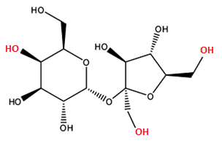
Sucralose vs Sucrose
Sucralose’s chemical name:
1,6,-dichloro-1,6-dideoxy-beta-D-fructofuranosyl-4-chloro-4-deoxy-alpha-D-galactopyranoside
?

Slide 5
How is it Made?
Producing the compound sucralose requires five steps (a patented process by Tate & Lyle):
Splenda International Patent A23L001:
Sucrose is tritylated with trityl chloride in the presence of dimethylformamide and 4-methylmorpholine, and the tritylated sucrose is then acetylated with acetic anhydride.
The resulting sucrose molecule TRISPA (6, 1’, 6’-tri-O-trityl-penta-O acetylsucrose) is chlorinated with hydrogen chlorine in the presence of toluene.
The resulting 4-PAS (sucrose 2, 3, 4, 3’, 4’- pentaacetate) is heated in the presence of methyl isobutyl ketone and acetic acid.
The resulting 6-PAS (sucrose 2, 3, 6, 3’, 4’-pentaacetate) is chlorinated with thionyl chloride in the presence of toluene and benzyltriethylamonium chloride.
The resulting TOSPA (sucralose pentaacetate) is treated with methanol in the presence of sodium methoxide to produce sucralose.

Slide 6
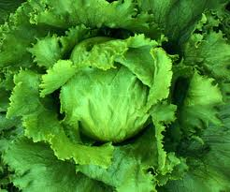
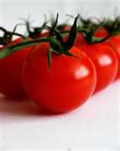
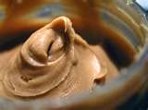
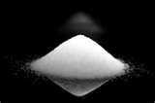
Friendly Chlorine
McNeil Nutritionals statements on chlorine :
http://www.splenda.com/faq/no-calorie-sweetener
Chlorine exists in nature as an ion in either a salt or an acid
KCl NaCl HCl
The atoms/ions to which Cl is connected is what matters!

Slide 7
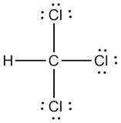
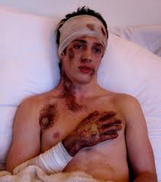
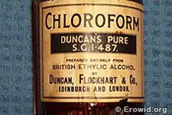
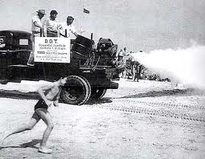
Splenda Structure
DDT
Chloroform
Sucralose
Mustard Gas

Slide 8
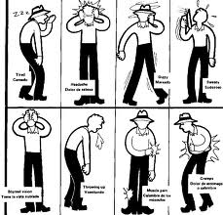
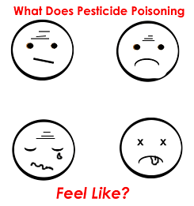
Could your sweetener be killing you?
The complaints and side effects attributed to Splenda by consumers are EXACT symptoms of pesticide poisoning!

Slide 9
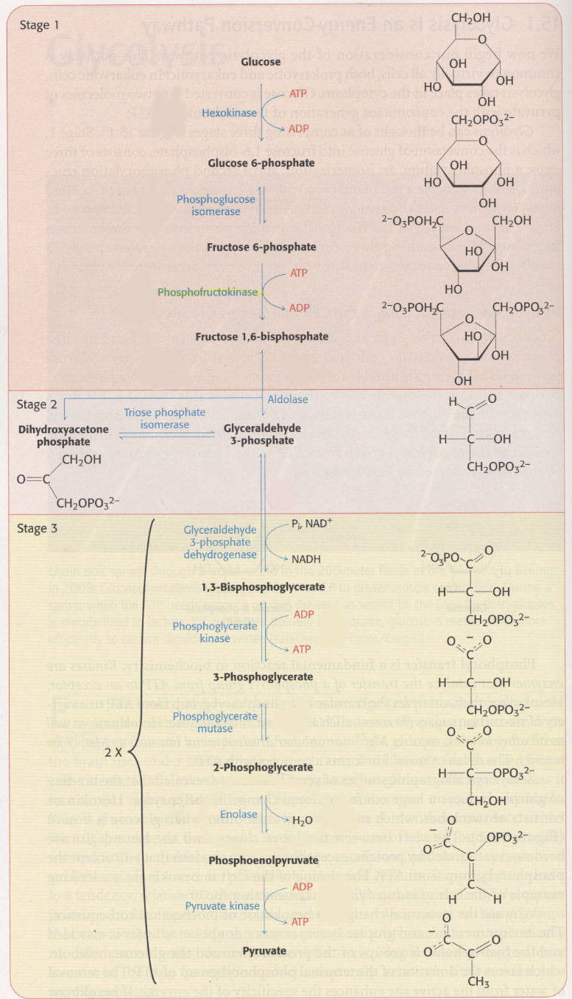
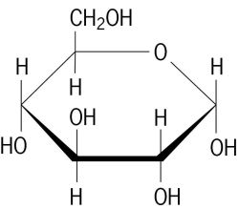
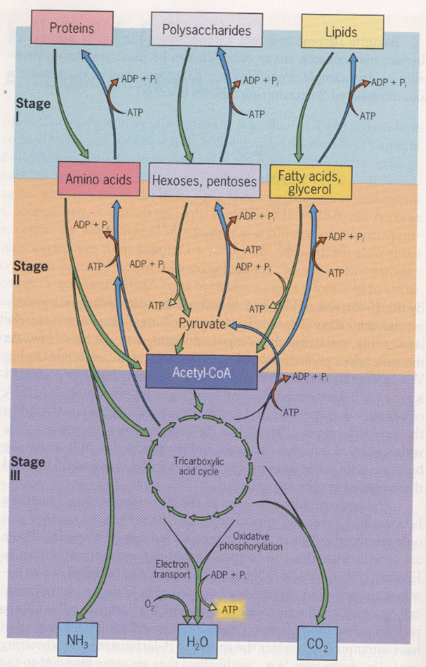
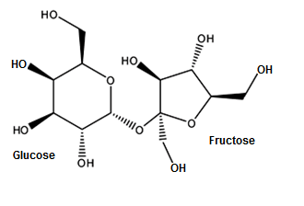
So why is splenda approved?
Of the 4 macromolecules of the body, 3 of them are directly funneled into metabolic pathway:
Lipids
Carbohydrates
Proteins
Glucose
Sucrose
McNeil Nutritionals states that sucralose is not recognized by the body as a carbohydrate so it does not metabolize the molecule

Slide 10
FDA Approval
The FDA regulations are set forth by Title 21 under the passage of the Pure Food and Drugs Act in 1906
Sweeteners or food additives can be of two statuses:
GRAS (Generally Recognized As Safe)
Approved for use
GRAS status sweeteners (Stevia) are approved for use by consumers- we can add it to our food if we choose
Approved for use sweeteners (artificial sweeteners) are approved for use by consumers and food manufacturers- manufacturers can produce their products with the additive in the ingredients.
Some sweeteners do not have to be listed because they
have been approved for use by the FDA

Slide 11
Drugs vs food at the fda
The approval process is much more clearly outlined and organized for a drug, yet food additive approval requirements are difficult to find for consumers.
Drug manufacturers are responsible for testing the safety of the drug and for submitting the relevant data to the FDA for review and approval
The first step in the testing and approval process requires the manufacturer to test the drug on animals in order to look for toxicity potential. If the drug passes this stage then the manufacturer has permission to perform human drug trials (Mercola, 2006).
According to Dr. Mercola, FDA reviewers are overloaded with information and documents that must be reviewed and evaluated in an unreasonable time. Leaving the testing up to the manufacturer leaves room for extreme bias.

Slide 12
An article written in the LA Times states that, “Thirty-nine percent [of FDA scientists] said the agency wasn't ‘acting effectively to protect public health’.” The shocking article goes on to state,
“In the questionnaire, 15% of the 997 FDA scientists who responded said they had been asked to "inappropriately" exclude or alter information or conclusions in agency documents for nonscientific reasons. Thirty-two percent said the FDA didn't routinely provide complete and accurate information to the public. And 37% said FDA leaders weren't as committed to product safety as to approving products for sale (Rockoff, 2006).”

Slide 13
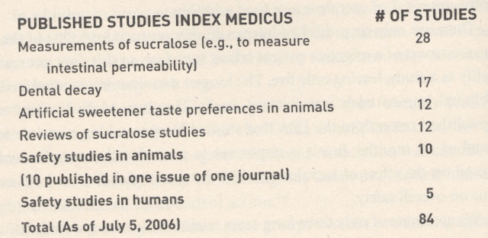
Splenda’s Side
McNeil cites many studies on Splenda’s safety:
http://www.splenda.com/faq/no-calorie-sweetener
There are very few studies that evaluate Splenda use long-term and the only long-term use study on humans was found to last only thirteen weeks.
The conclusion of this study was that long-term sucralose use was found to be safe in humans.

Slide 14
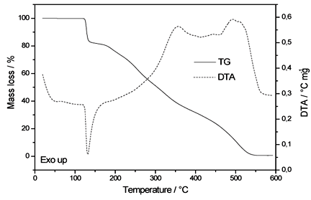
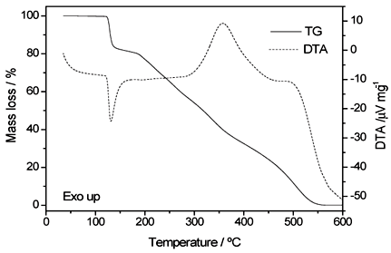
The two images below depict the mass loss, or breakdown, of the sucralose over a temperature range; the breakdown associated with a loss of HCl and H₂O
In a study performed in Brazil at the Universidade Estadual de Ponta Grossa, the thermochemical breakdown of sucrose was analyzed by thermoanalytical techniques.
Splenda obtained from a local drugstore was heated and its composition continuously observed before, during, and after the heating process revealing that sucralose is stable up to 119°C, about 246°F, after which it breaks down in three steps up to over 1000°F.

Slide 15
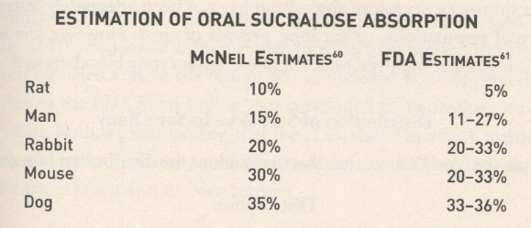
Absorption of sucralose
McNeil claims that about 85% of the product is not absorbed by the body and is excreted unchanged in the stool.
The amount that is absorbed is excreted unchanged in the urine within 24 hours.

Slide 16
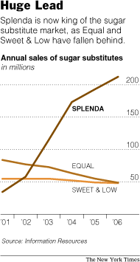
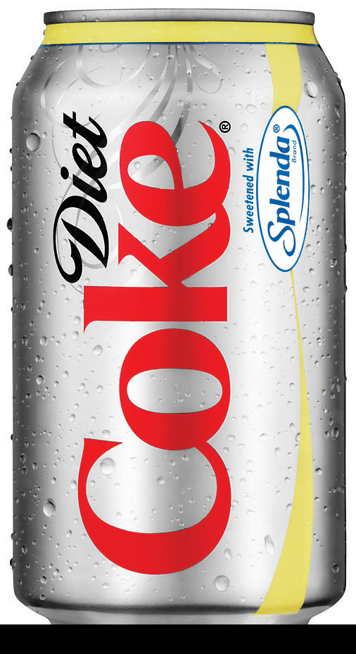
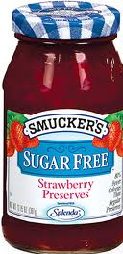
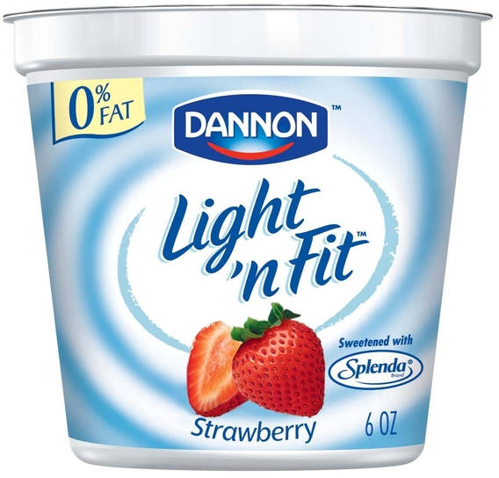
Economics
Approved in 80 countries
Found in 4,500 consumer products like gum, diet soda, mints
Sold to manufacturers as sucralose and to consumers as Splenda
Gaining popularity because it teams-up with other manufacturing companies and products
$ 1.5 billion industry of which Splenda own 62% of the market share in 2006.

Slide 17
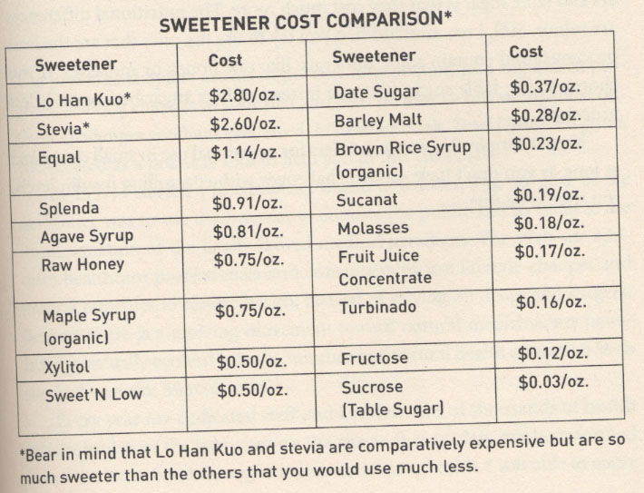
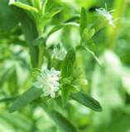
Splenda’s Future
Right now Splenda sales are on the rise and more companies are jumping on board
There is one study listed that is currently looking for volunteers in order to perform more tests on the metabolism of Splenda – this one is not sponsored by McNeil
There have been no tests on how it reacts with other sugar, alcohol, and medications
The safest sweeteners are Stevia, honey, and plain old sugar

Slide 18
Bibliography (Timeline)
California Institute of Technology. (2004, 11 08). About the Division of Biology. Retrieved 02 23, 2011, from Biology Division: http://biology.caltech.edu/about/history/1980s.html
Gascoigne, B. (2001). History of Medicine. Retrieved 02 23, 2011, from Historyworld: http://www.historyworld.net/wrldhis/PlainTextHistories.asp?groupid=476&HistoryID=aa52&gtrack=pthc
HistoryTimelines.org. (n.d.). History of Medicine Timeline. Retrieved 02 23, 2011, from History Timelines: http://www.history-timelines.org.uk/events-timelines/10-history-of-medicine-timeline.htm
Honey, the Medicine of Choice for Many. (2010, 07 31). Retrieved 02 23, 2011, from Health For You: http://usaeu.net/2010/07/honey-the-medicine-of-choice-for-many/
Major Discoveries in Biology. (n.d.). Retrieved 02 23, 2011, from Smith Life Science: http://www.smithlifescience.com/MajDiscoveriesbiology.htm
Mercola, D. J. (2006). Sweet Deception: Why Splenda, NutraSweet, and the FDA May Be Hazardous to Your Health. Nashville: Thomas Nelson, Inc.
Peack, M. (2002, 10). History of Chemical Engineering. Retrieved 02 23, 2011, from What is Chemical Engineering: http://www.ceb.cam.ac.uk/exemplarch2002/mcp21/history.html
The Honey Association. (n.d.). A Brief History of Honey. Retrieved 02 23, 2011, from Honey Association: http://www.honeyassociation.com/history.htm
Wikipedia.org. (2011, 02 20). Ayurveda. Retrieved 02 23, 2011, from Wikipedia: http://en.wikipedia.org/wiki/Ayurveda

Slide 19
Bibliography
http://www.odomcorp.com/store/products/diet-coke-with-splenda. The Odom Corporation.
Baird, M. I., Shephard, N., Merritt, R., & Hildick-Smith, G. (2000). Repeated dose study of sucralose tolerance in human subjects. Food and Chemical Toxicology , 123-129.
Bannach, G., Almeida, R. R., Lacerda, L. G., Schnitzler, E., & Ionashiro, M. (2009). Thermal stability and thermal decomposition of sucralose. Eclética Química .
Boyles, S. (2008). Do Lo-Cal Sweeteners Encourage Eating? CBSnews Healthwatch .
Browning, L. (2007, 04 6). Makers of Artificial Sweeteners Go to Court. New York Times .
Brusick, D., Grotz, V., Slesinski, R., Kruger, C., & Hayes, A. (2010). The absence of genotoxicity of sucralose. Food and Chemical Toxicology , 3067-72.
California Institute of Technology. (2004, 11 08). About the Division of Biology. Retrieved 02 23, 2011, from Biology Division: http://biology.caltech.edu/about/history/1980s.html
CNN. (2006, 09 13). Skinny models banned from catwalk. Retrieved 03 02, 2011, from CNN.com: http://articles.cnn.com/2006-09-13/world/spain.models_1_association-of-fashion-designers-skinny-models-pasarela-cibeles?_s=PM:WORLD
Environmental Nutrition. (2002, 10). Sucralose (Splenda): How Sweet It Is... or Perhaps Isn't? Environmental Nutrition , p. 7.
Farlex. (2011). Glucose. Retrieved 04 04, 2011, from The Free Dictionary: http://encyclopedia2.thefreedictionary.com/Glucose
Gascoigne, B. (2001). History of Medicine. Retrieved 02 23, 2011, from Historyworld: http://www.historyworld.net/wrldhis/PlainTextHistories.asp?groupid=476&HistoryID=aa52&gtrack=pthc
Grice, C., & Goldsmith, L. (2000). Sucralose—an overview of the toxicity data . Food and Chemical Toxicology , 1-6.
HistoryTimelines.org. (n.d.). History of Medicine Timeline. Retrieved 02 23, 2011, from History Timelines: http://www.history-timelines.org.uk/events-timelines/10-history-of-medicine-timeline.htm
Honey, the Medicine of Choice for Many. (2010, 07 31). Retrieved 02 23, 2011, from Health For You: http://usaeu.net/2010/07/honey-the-medicine-of-choice-for-many/
International Finance Corporation. (2010). DDT scores a new victory as a malaria fighter. Retrieved 04 04, 2011, from Private Sector Development Blog: A market approach to development thinking: http://psdblog.worldbank.org/psdblog/2007/08/ddt-scores-a-ne.html

Slide 20
Karp, G. (2010). Cell and Molecular Biology (6th ed.). Hoboken, New Jersey: John Wiley & Sons, Inc.
Major Discoveries in Biology. (n.d.). Retrieved 02 23, 2011, from Smith Life Science: http://www.smithlifescience.com/MajDiscoveriesbiology.htm
McNeil Nutritinals, LLC. (2011). Our Family of Products. Retrieved 04 03, 2011, from Splenda.com: http://www.splenda.com/products
McNeil Nutritionals, LLC. (2003, 01 7). Material Safety Data Sheet: Splenda Brand Sucralose. Retrieved 04 04, 2011, from 3E MSDS : http://www.msds.com/servlet/B2BDocumentDisplay?document_version_nri=640005&manuf_nri=12917&manuf_name=&supplier_nri=12917&page_number=1&search_source=centraldb&CLIENT_session_key=A598458_ktweagle&CLIENT_language=2
McNeil Nutritionals, LLC. (2011). Splenda Products FAQs. Retrieved 04 04, 2011, from Splenda.com: http://www.splenda.com/faq/no-calorie-sweetener
Mercola, D. J. (2006). Sweet Deception: Why Splenda, NutraSweet, and the FDA May Be Hazardous to Your Health. Nashville: Thomas Nelson, Inc.
Peack, M. (2002, 10). History of Chemical Engineering. Retrieved 02 23, 2011, from What is Chemical Engineering: http://www.ceb.cam.ac.uk/exemplarch2002/mcp21/history.html
Pope, J. V. (2010, 05 11). Toxicity, Organochlorine Pesticides Clinical Presentation. Retrieved 04 04, 2011, from MedScape reference: http://emedicine.medscape.com/article/815051-clinical#a0217
Rockoff, J. D. (2006, 07 21). FDA Scientists Report Their Safety Concerns in Poll. The Los Angeles Times .
Snapshot: Splenda. (2011). Retrieved 04 04, 2011, from Kosmix: http://www.kosmix.com/topic/splenda

Slide 21
The Honey Association. (n.d.). A Brief History of Honey. Retrieved 02 23, 2011, from Honey Association: http://www.honeyassociation.com/history.htm
Tymoczko, J. L., Berg, J. M., & Stryer, L. (2010). Biochemistry: A Short Course. New York: W.H. Freeman and Company.
U.S. Food and Drug Administration. (2010, 07 29). About the FDA: History. Retrieved 04 04, 2011, from U.S. Food and Drug Administration: http://www.fda.gov/AboutFDA/WhatWeDo/History/default.htm
U.S. Food and Drug Administration. (2010, 04 01). Code of Federal Regulations Title 21. Retrieved 04 04, 2011, from U.S. Food and Drug Administration: http://www.accessdata.fda.gov/scripts/cdrh/cfdocs/cfcfr/CFRSearch.cfm?CFRPart=101&showFR=1
U.S. Food and Drug Administration. (2010, 04 23). How Drugs are Developed and Approved. Retrieved 04 04, 2011, from U.S. Food and Drug Administration: http://www.fda.gov/Drugs/DevelopmentApprovalProcess/HowDrugsareDevelopedandApproved/default.htm
Wikipedia.org. (2011, 02 20). Ayurveda. Retrieved 02 23, 2011, from Wikipedia: http://en.wikipedia.org/wiki/Ayurveda
Wikipedia.org. (2011, 03 22). Stevia. Retrieved 04 04, 2011, from Wikipedia.org: http://en.wikipedia.org/wiki/Stevia
Wing, K. (2010). Splenda versus Glucose in Yeast Metabolism. Naples, FL.
Zimmerman, M. (1995). Science, Nonscience, and Nonsense. Baltimore: The Johns Hopkins University Press.

